Slide 1

Building a Data Science Architecture
12 December 2018
Presented By:
Eric Thornton
For Questions, Comments or Clarifications Contact:
ET@ChameleonMetadata.com

Slide 2
Why Do We Need A Data Science Architecture?
The 80/20 Data Science Dilemma:
A Data Scientist, Data Expert, or whatever your company calls them, typically spend only 20% of their time analyzing datasets. The other 80% of their time is spent finding, cleaning, and reorganizing huge amounts of data, which is an inefficient data strategy ^{[1]}
Only 15% of Big Data Projects Succeed:
In November 2016 Gartner estimated that 60% of big data projects fail. A year later, Gartner’s Nick Heudecker said the 60% estimate was "too conservative“ saying the failure rate was really "[C]loser to 85 percent." ^{[2]}
[1] https://www.infoworld.com/article/3228245/data-science/the-80-20-data-science-dilemma.html
[2] https://www.techrepublic.com/article/85-of-big-data-projects-fail-but-your-developers-can-help-yours-succeed/
Copyright 2018 – Chameleon Metadata

Slide 3
Why Do We Need A Data Science Architecture?
Exposing Tribal Knowledge:
Despite having the technical infrastructure in place, different departments are often reluctant to share their data.
Better Data Governance:
A lack of effective data governance within data lakes prevents users from trusting the system, so they hoard their data instead. As a result, its value is lost to the rest of the company.
Data owners need to have confidence that the data they share will be accessed, used and protected appropriately.
Even if users are persuaded to share their data, it can be difficult to decide:
How to share it
What kind of data cleansing and preprocessing needs to happen before it is safe for others to use.
Most organizations mistakenly believe that answering these questions may require yet another large IT investment.
Cataloging Datasets You Already Have:
Finding datasets with the information needed for hypothesis testing
This issue is often exacerbated when companies treat their data lake as a dumping ground for assets, rather than a well-organized and actively managed archive. In these circumstances, it is difficult for users to find or understand assets within the data lake, and when they do, they are of questionable quality and unknown provenance.
Copyright 2018 – Chameleon Metadata

Slide 4
Case Study - Journal of Petroleum Technology (JPT)
Staff at large energy company told the Journal of Petroleum Technology (JPT) they found their engineers sometimes spent weeks collecting the subsurface, operations, maintenance, and finance datasets needed to do basic analysis on something such as oil well performance.
Their analysts can now bypass the time-consuming data curation process and begin performing analysis much quicker thanks to their integrated data warehouses (IDWs) which serve as centralized data stores for staff involved in various disciplines.
Deployment has resulted in improved well uptime, decreased drilling times, optimized completion designs, and increased understanding of subsurface characteristics, the company says.
But, integrating and making data transparent across multiple functions “requires some governance to make sure we’re applying that data to the right case at the right time,” the company told JPT. “There’s financial information, there’s subsurface information, and there’s production information that, all out of context, could mislead you.
“So we’ve established a data governance process that has identified owners of the data—or functional owners across the business—who we bring together in this collaborative group to discuss the types of data that we’re storing in our warehouse, the access requirements for the data, the conditioning of it, and the various uses to make sure no one is being misled with the application of that data.”
[3] Journal of Petroleum Technology (JPT) - https://www.spe.org/en/jpt/jpt-article-detail/?art=4170
Copyright 2018 – Chameleon Metadata

Slide 5
Robotic Process Automation
The Beatles saved the world from boredom. Can a cutting-edge technology known as Robotic Process Automation (RPA) do the same for the workplace and take the robot out of the human? ^{[4]}
The Robotic Process Automation market is advancing at a rapid clip. “Market growth is exceeding our greater than 50% CAGR to get from $500 million to $2.8 billion in five years,” said Craig Le Clair, an analyst at Forrester. “That’s very unusual.” ^{[5]}
The major benefit we found in the 16 case studies [is] a return on investment that varies between 30 and as much as 200 percent in the first year. But it’s wrong to look just at the short-term financial gains. That approach does not do justice to the power of the software because there are multiple business benefits. ^{[6]}
Python is known for the abundance of excellent libraries backed by large communities of programmers . . .
Why not really leverage all those libraries?
[4] Forbes - https://www.forbes.com/sites/forbescommunicationscouncil/2018/08/15/how-rpa-is-changing-the-way-we-work/#579b7b911047
[5] TechTarget - https://searchcio.techtarget.com/blog/TotalCIO/In-a-hot-RPA-market-the-rule-of-five-keeps-CIOs-focused-on-use-cases
[6] McKinsey - https://www.mckinsey.com/industries/financial-services/our-insights/the-value-of-robotic-process-automation
[Graphic] Deloitte Analysis - https://www2.deloitte.com/content/dam/Deloitte/us/Documents/process-and-operations/us-sdt-process-automation.pdf
Copyright 2018 – Chameleon Metadata

Slide 6
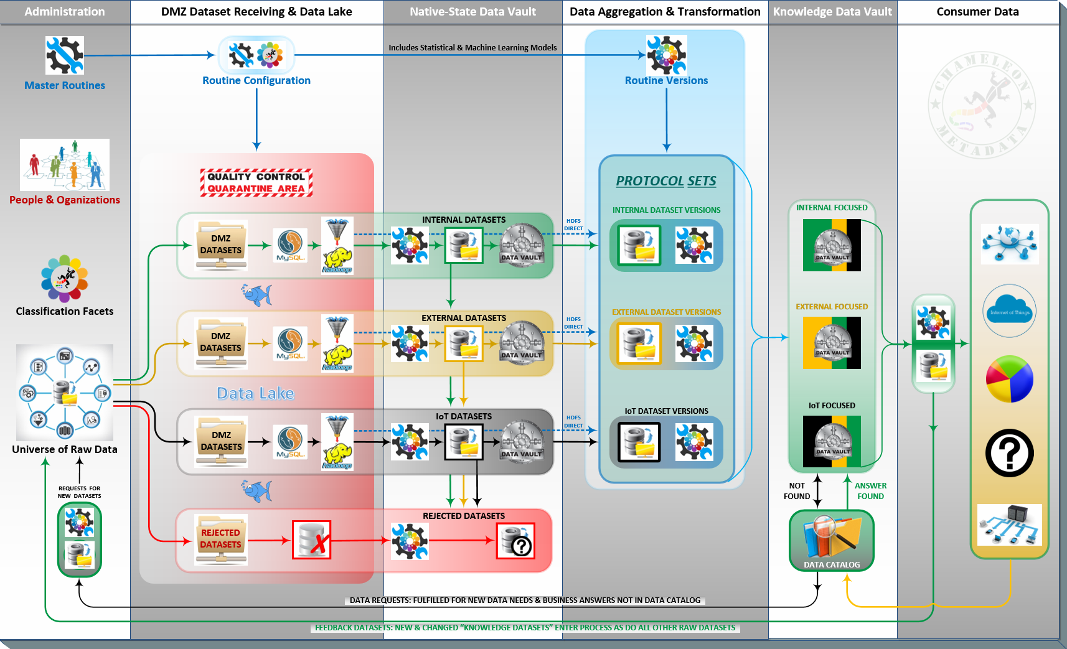
Data Science Architecture Overview
Copyright 2018 – Chameleon Metadata

Slide 7
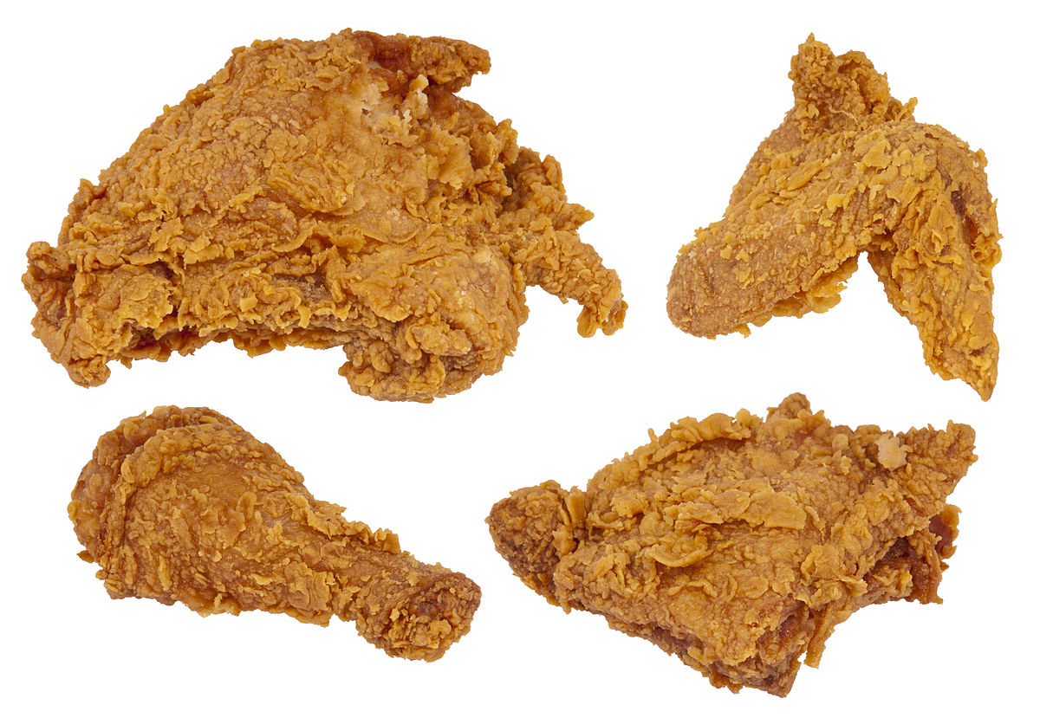

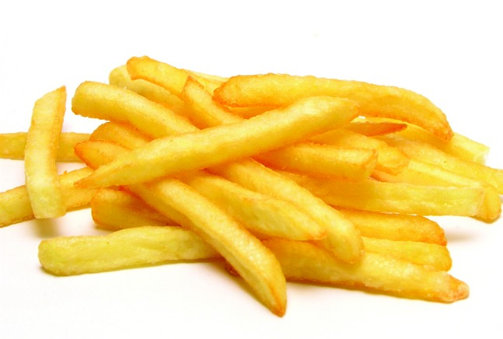
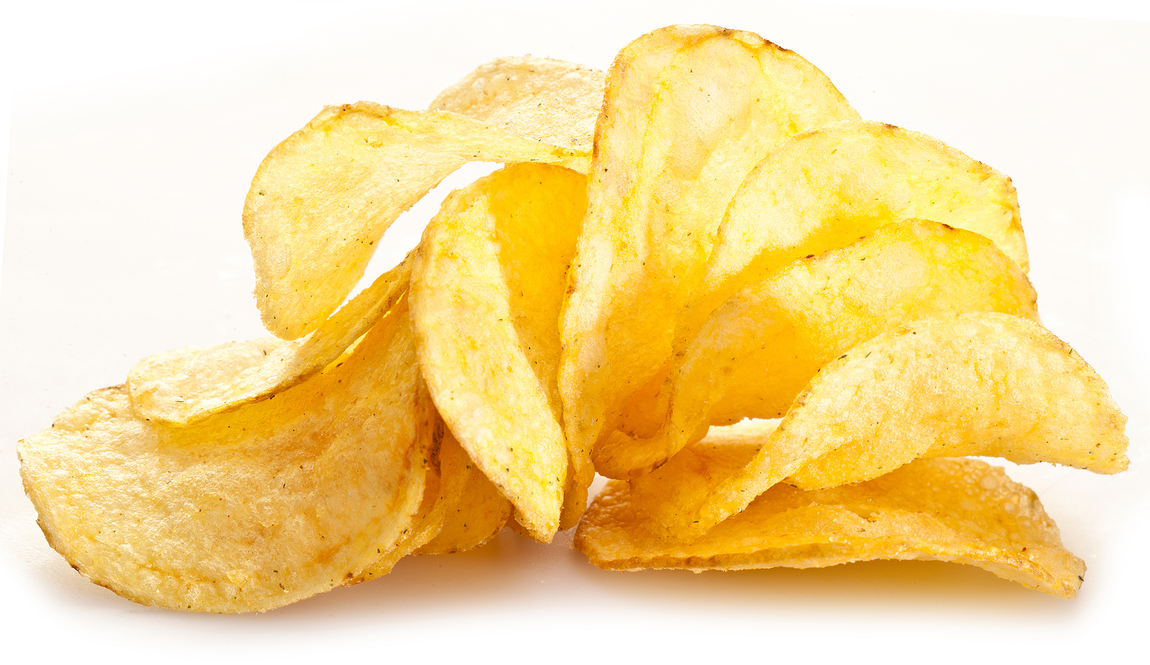
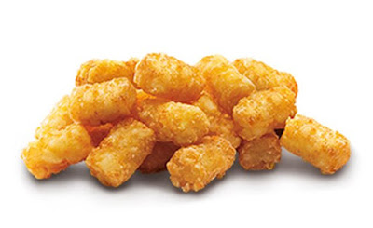
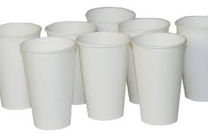

Describing Business Concepts Is Hard
When a business has simple business processes, business concepts are easy to describe
Fried Chicken.
Candy.
French Fries.
Potato Chips.
Tater Tots.
Paper Cups.
Paper Plates.
FOOD PRODUCTS
NON-FOOD PRODUCTS
Copyright 2018 – Chameleon Metadata

Slide 8
Describing Business Concepts Is Hard
But, as a company’s business processes become more complex, business concepts are less simple to describe
FOOD PRODUCTS WITHOUT
POTATOS
Fried Chicken.
Candy.
French Fries.
Potato Chips.
Tater Tots.
Paper Cups.
Paper Plates.
Whereas we only needed one descriptor on the last slide (Food, or Not Food), with the new descriptive requirement, we now need to break the ‘Food’ category down further (Contains Potato ?)
FOOD PRODUCTS WITH
POTATOS
NON-FOOD PRODUCTS
Copyright 2018 – Chameleon Metadata

Slide 9
Describing Business Concepts Is Hard
Potato Chips.
French Fries.
Tater Tots.
Fried Chicken.
Candy.
Paper Cups.
Paper Plates.
Notice that the ways ‘The Business’ groups products change depending on which part of ‘The Business’ is designing the groups (a.k.a. hierarchies)
Finance hierarchies are concerned with groups like ‘Food’ or ‘Non-Food’. Or, not shown here: grouping business units by location: North America; South/Central America; EU; Africa; and Asia/Pacific.
Manufacturing hierarchies are more concerned with materials and logistics (i.e. Frozen/Not Frozen or Contains Potatoes/No Potatoes)
These built-for-purpose hierarchies rarely align across the purpose for which they were specifically designed.
This situation is very common when one company acquires another or a company moves from one ERP or CRM platform to another
Chameleon Metadata’s Flexible Hierarchies Management tools and processes allows us to identify misaligned hierarchies in advance.
‘What If’ hierarchies can be built before they’re needed and verified to identify risks/issues before a formal roll-out into Production.
So, client can ‘see a taxonomy issue’ before it breaks anything.
CONTAINS POTATO
FOOD PRODUCTS
FROZEN
NO POTATOES NO POTATOES
NON-FOOD
Copyright 2018 – Chameleon Metadata

Slide 10
Describing Business Concepts Is Hard
Taxonomies: Common Product Hierarchy Levels
Each product is related to certain other products. The product hierarchy stretches from basic needs to particular items that satisfy those needs. There are 7 product hierarchy types which are most common:
Need family: The core need that underlines the existence of a product family. Let us consider Food as one of needs.
Product family: All the product classes that can satisfy a core need with reasonable effectiveness. For example, all of the products like Frozen, Bakery or Drinks are food families.
Product class: A group of products within the product family recognized as having a certain functional coherence. For instance, Bread is one product class.
Product line: A group of products within a product class that are closely related because they perform a similar function, are sold to the same customer groups, are marketed through the same channels or fall within given price range. For instance, Pasta is one product line.
Product type: A group of items within a product line that share one of several possible forms of the product. For instance, Macaroni is one product type.
Brand: The name associated with one or more items in the product line that is used to identity the source or character of the items. For example, Bertolli is one brand of Pasta.
Item/stock-keeping unit/product variant: A distinct unit within a brand or product line distinguishable by size, price, appearance or some other attributes. For instance Long, Lasagna and Spaghetti are various items under Pasta top product type.
Copyright 2018 – Chameleon Metadata
10

Slide 11
Taxonomies: Product Mix and Product Lines
But organizations often also group the same products into their own distinct ‘units’ because of marketing, technical or end-use considerations. The four most common, non-technical hierarchy types would be:
Width: This refers to how many different product lines the company carries.
Depth: This refers to how many variants, shades, models, pack sizes etc. are offered of each product in the line
Length: This refers to the total number of items in the mix.
Consistency: This refers to how closely the various product lines are related in end use, production requirements, distribution channels or some other way.
Regardless the specifics, companies end up grouping their products, people, process, organizations and locations in a lot of different ways based on the unique needs of the many different groups using it.
Copyright 2018 – Chameleon Metadata
11

Slide 12
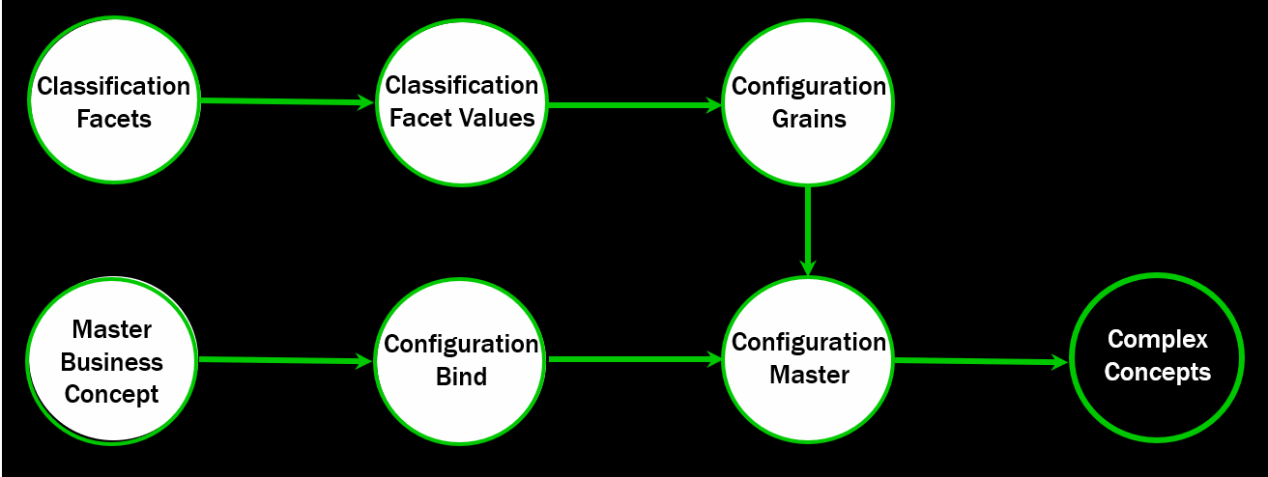
Identifying Entities Using Features
Master Entities – High-level business concepts
Proposal, Employee, Opportunity, Certification, etc.
Configuration Master Entities – Versions of or ‘roles’ an entity may assume – primarily a label
The ACME company may be your company’s client, vendor or both; depending on the transactional context
Configuration Grains (a.k.a. Features) – A collection of attribute values which, when taken as a group:
Uniquely identify a single Configuration Master as being described by a specific and unique collection of features
Taken as a group, {First_Name + Last_Name + Birthdate + ZIP Code} uniquely ID a person to almost 6 std. deviations
Configuration Bind Entities – Relates a Master entity to Configurations or Versions of itself
The City of Cambridge, MA is Bound to two (2) Configurations which appear the same, but one has ‘DPW’ in its name
Copyright 2018 – Chameleon Metadata

Slide 13
Identifying Data Using Relationships
Data links are identified by more than one Entity Occurrence sharing the same Classification Facet Value(s)
Copyright 2018 – Chameleon Metadata

Slide 14
Identifying Data Using Relationships
This approach also positions your organization to start using Graph Databases (like Neo4j)
[Source] Neo4j - https://neo4j.com/graphgist/bank-fraud-detection
Copyright 2018 – Chameleon Metadata

Slide 15
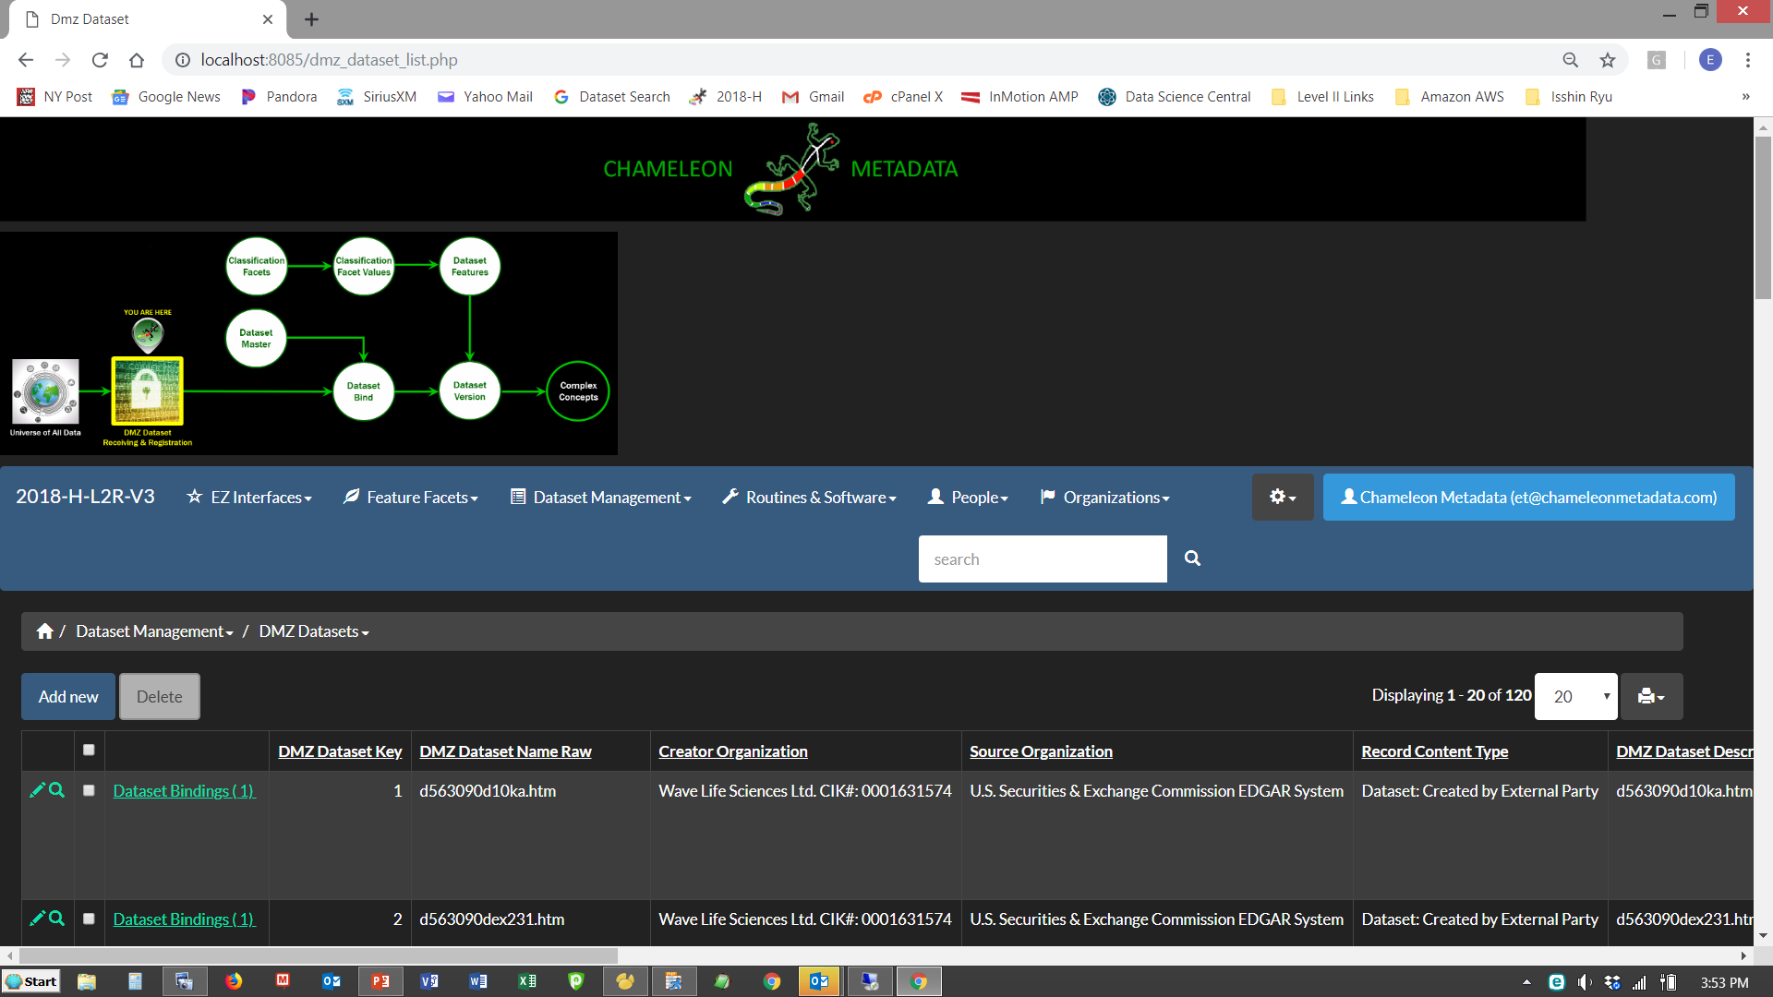
Entities Roles Using Feature Combinations
Copyright 2018 – Chameleon Metadata

Slide 16
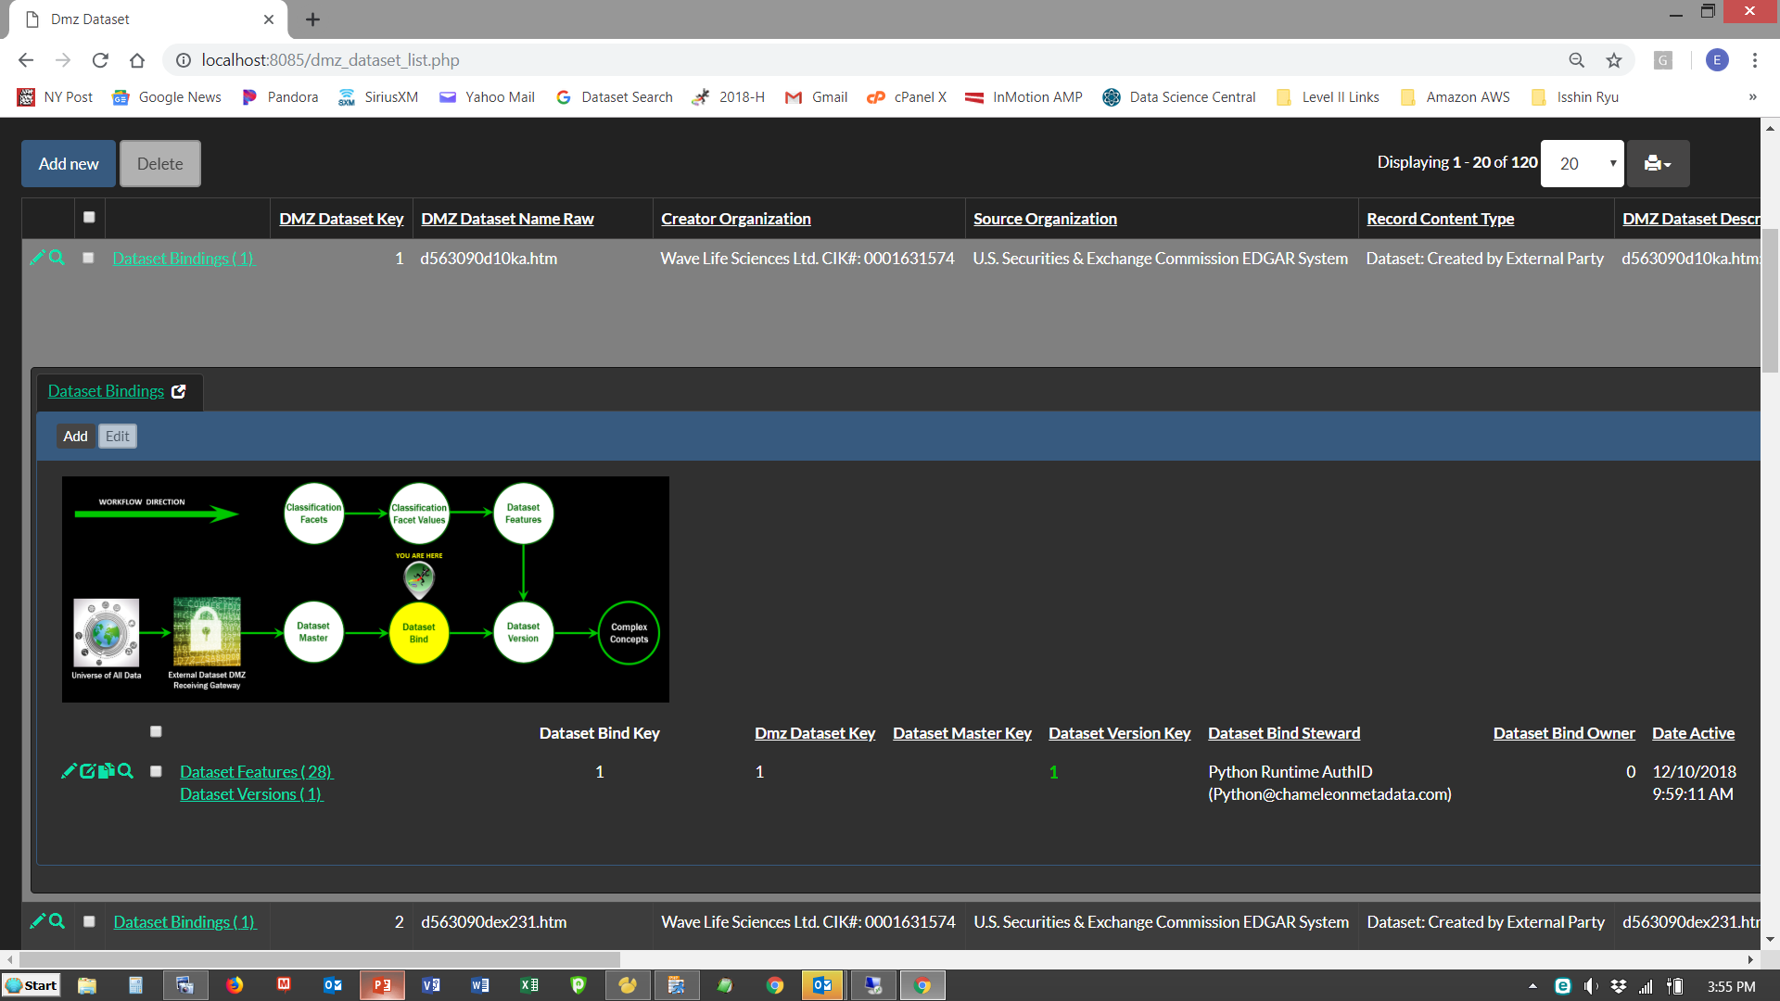
Entities Roles Using Feature Combinations
Copyright 2018 – Chameleon Metadata

Slide 17
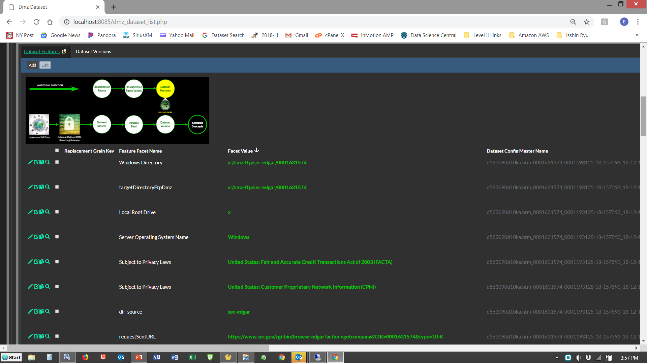
Entities Roles Using Feature Combinations
Copyright 2018 – Chameleon Metadata

Slide 18
Entities Roles Using Feature Combinations
Copyright 2018 – Chameleon Metadata

Slide 19
Classification Facets (Features)
Copyright 2018 – Chameleon Metadata

Slide 20
Classification Facets Values (Feature Values)
Copyright 2018 – Chameleon Metadata

Slide 21
Tiny Rows Mean Super-Fast Performance
Copyright 2018 – Chameleon Metadata

Slide 22
Using ‘Copybooks’ To Standardize RPA Tasks
Copyright 2018 – Chameleon Metadata

Slide 23
Using ‘Copybooks’ To Standardize RPA Tasks
#
#~~~ ~~~~
#
edgarfetch_log_list.append('EdgarFetch - Creator Org Configuration INSERT Statement: ‘)
edgarfetch_log_list.append(' ')
org_config_select_string = ('SELECT org_config_master_key FROM organization_config_master WHERE org_config_master_name = ' + "'" + edgar_companyName_text + "'")
if creator_org_master_key == 0:
org_config_master_notes = 'DATA GOVERNANCE ALERT: No Valid (creator_org_master_key) was provided at runtime. Setting (creator_org_master_key) = 0 for further investigation'
org_config_insert_string = ('INSERT INTO organization_config_master VALUES (NULL , ' + str(3) + ' , 0, 0, NULL, CURRENT_TIMESTAMP, NULL' + ', ' + "'" + edgar_companyName_text + "'" + ', ' + “’” + org_config_master_notes + "'" + ')')
else:
org_config_insert_string = ('INSERT INTO organization_config_master VALUES (NULL , ' + str(3) + ' , 0, 0, NULL, CURRENT_TIMESTAMP, NULL' + ', ' + "'" + edgar_companyName_text + "'" + ', NULL)')
try:
org_config_creator_sql_array = numpy.array([str(creator_org_master_key), org_config_select_string , org_config_insert_string])
numpy_creator_org_config_sql_array = numpy.append(numpy_creator_org_config_sql_array, [org_config_creator_sql_array], axis=0)
edgarfetch_log_list.append(org_config_insert_string)
edgarfetch_log_list.append('_____________________________________________________________________')
except:
edgarfetch_log_list.append('ERROR: EdgarFetch - Routine Configuration INSERT Statement - Execution Aborting')
edgarfetch_log_list.append(' ~ DUMP: routine_master_key = ' + str(routine_master_key))
edgarfetch_log_list.append(' ~ DUMP: ' + routine_config_select_string)
edgarfetch_log_list.append(' ~ DUMP: ' + routine_config_insert_string)
sys.exit("ERROR: EdgarFetch - Routine Configuration INSERT Statement - Execution Aborting")
edgarfetch_log_list.append(' ')
Copyright 2018 – Chameleon Metadata

Slide 24
Using ‘Copybooks’ To Standardize Coding
wss_sql_statement_class_facet = class_facet_8000857
wss_sql_statement_cfv_value_alpha = hadoop_target_cluster_id
wss_is_org_config_grain = 'N'
wss_is_routine_config_grain = 'Y'
wss_is_dataset_config_grain = 'Y'
facet_value_select_string = ('SELECT class_facet_value_key FROM chameleon_class_facet_value WHERE classification_facet_key = ' + str(wss_sql_statement_class_facet) + ' AND cfv_value_alpha = ' + "'" + wss_sql_statement_cfv_value_alpha + "'")
facet_value_insert_string = ('INSERT INTO chameleon_class_facet_value VALUES (NULL , ' + str(wss_sql_statement_class_facet) + ' , ' + "'" + wss_sql_statement_cfv_value_alpha + "'" + ' , NULL ,NULL ,NULL ,NULL , 0, 0, CURRENT_TIMESTAMP, NULL, NULL)')
facet_value_sql_string = ('(' + str(wss_sql_statement_class_facet) + ',' + facet_value_select_string + ',' + facet_value_insert_string + ')')
facet_value_sql_array = numpy.array([str(wss_sql_statement_class_facet), facet_value_select_string , facet_value_insert_string])
if wss_is_routine_config_grain == 'Y':
if facet_value_sql_string not in routine_facet_value_sql_list:
routine_facet_value_sql_list.append(facet_value_sql_string)
numpy_routine_facet_value_sql_array = numpy.append(numpy_routine_facet_value_sql_array, [facet_value_sql_array], axis=0)
if wss_is_org_config_grain == 'Y':
if facet_value_sql_string not in org_facet_value_sql_list:
org_facet_value_sql_list.append(facet_value_sql_string)
numpy_org_facet_value_sql_array = numpy.append(numpy_org_facet_value_sql_array, [facet_value_sql_array], axis=0)
numpy_org_facet_value_sql_array = numpy.append(numpy_org_facet_value_sql_array, [facet_value_sql_array], axis=0)
if wss_is_dataset_config_grain == ‘Y’:
dataset_facet_value_sql_list.append(facet_value_sql_string)
numpy_dataset_facet_value_sql_array = numpy.append(numpy_dataset_facet_value_sql_array, [facet_value_sql_array], axis=0)
new_dmz_dataset_config_grain_array = numpy.array([dmz_dataset_key, wss_sql_statement_class_facet, wss_sql_statement_cfv_value_alpha])
numpy_new_dmz_dataset_config_grain_array = numpy.append(numpy_new_dmz_dataset_config_grain_array, [new_dmz_dataset_config_grain_array], axis=0)
Copyright 2018 – Chameleon Metadata

Slide 25
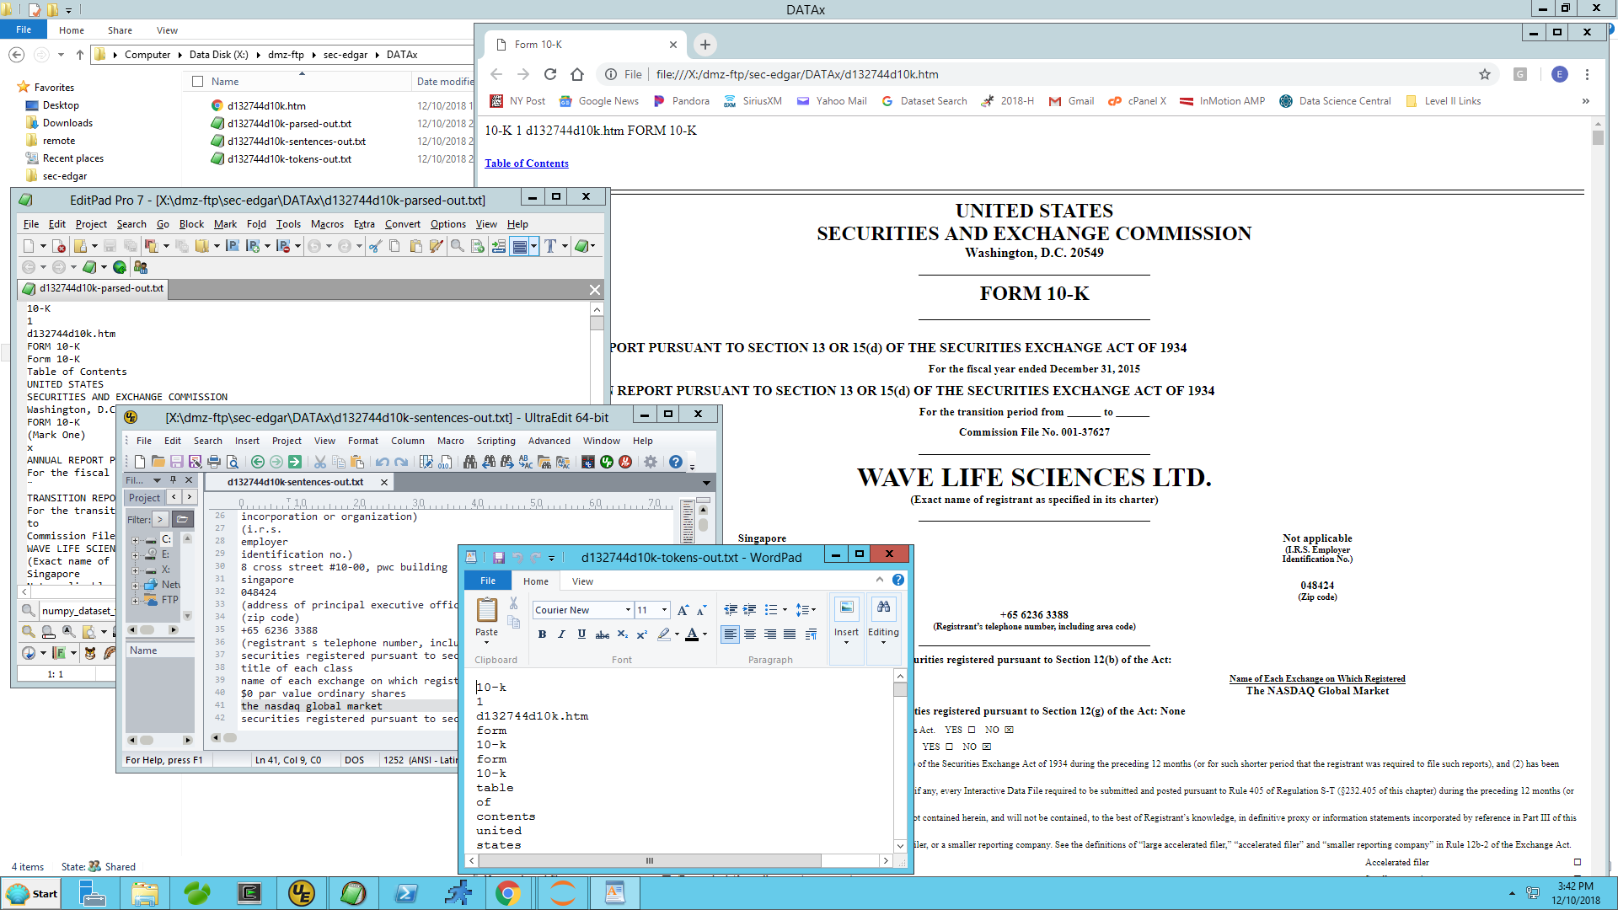
Preprocessing Spawns Many Child-Datasets
Copyright 2018 – Chameleon Metadata

Slide 26
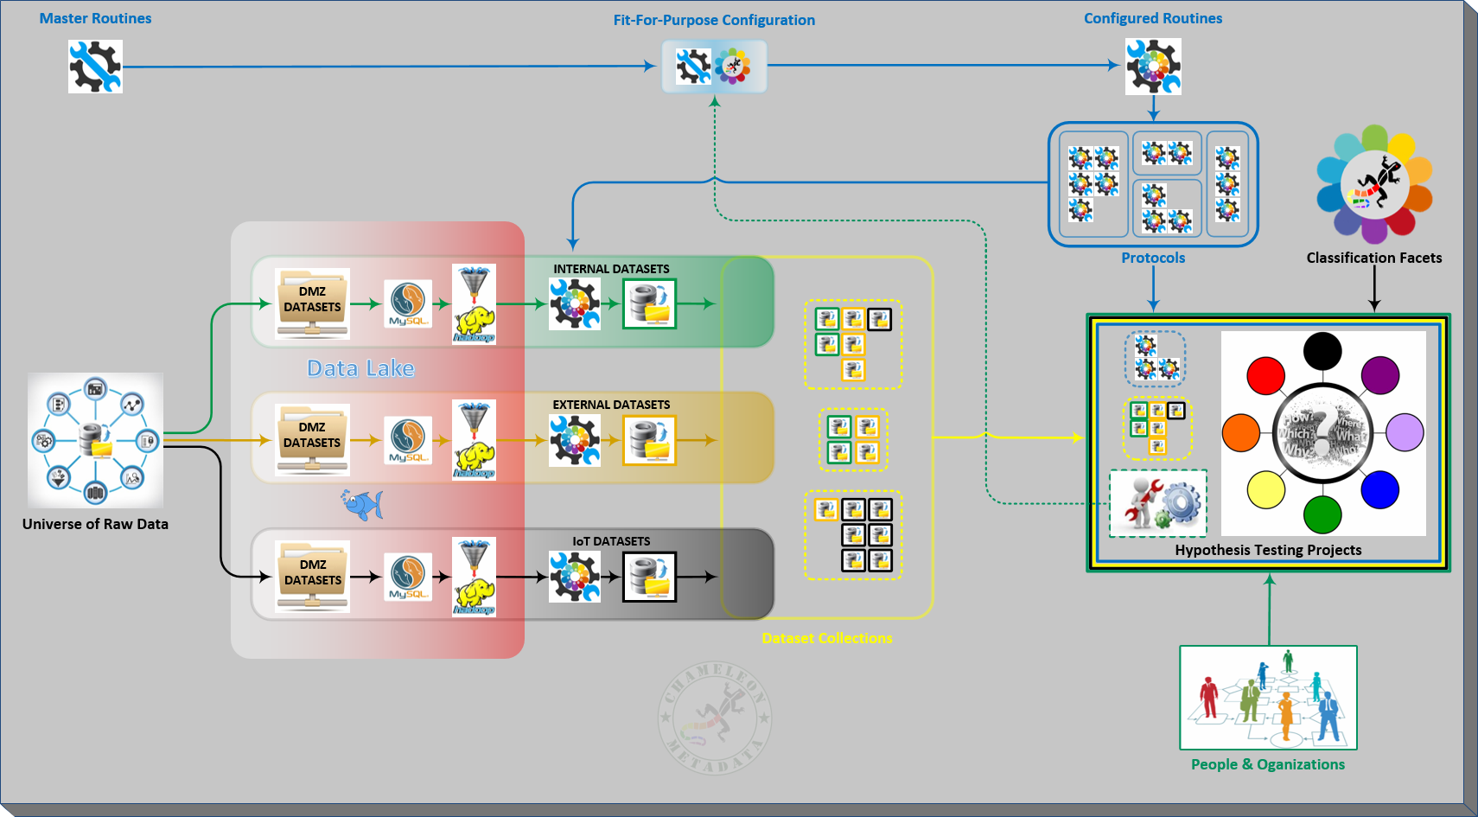
Data Analysis & Hypothesis Testing Needs Many Datasets
Copyright 2018 – Chameleon Metadata

Slide 27
Data Science Architecture Overview - Revisited

Slide 28
Have A Solid Plan . . . For Keeping Your Initiative Funded

Slide 29



It’s An Iterative Process – Don’t Try And Do It All Day-1
10-K & 10-KA Filings 1st ?
Copyright 2018 – Chameleon Metadata
29

Slide 30


Copies of the Python Code Are Available At Our GitHub Site:
https://github.com/chameleonmetadata/DATAx_NYC_2019
For Questions, Comments or Clarifications Contact:
ET@ChameleonMetadata.com
New York: (+1) 646.688.5566
London: (+44) 020.7096.8920
Copyright 2018 – Chameleon Metadata
30

